Slide 1
Computer Organization and Assembly Language
Week 1 to 3
Dr. Muhammad Nouman Durrani

Slide 2
Introduction
Definition 1:
Computer organization is concerned with the way hardware components operate and the way they are connected together to form a computer system.
Definition 2:
Computer organization is concerned with the structure and behavior of a computer system.
Definition 3:
Assembly language consists of statements written with short mnemonics such as ADD, MOV, SUB, and CALL.

Slide 3
Introduction
The main objective of this course is to:
Understand the basic structure of a computer system
How to write programs by understanding the hardware structure

Slide 4
Assembly Language Programming
An assembly language is a low-level programming language designed for a specific type of processor
Assembly language is used to write the program using alphanumeric symbols (or mnemonic), e.g. ADD, MOV, PUSH etc.
Assembly Language depends on the machine code instructions
Every assembler has its own assembly language
Assembly language has a one-to-one relationship with machine language:
Each assembly language instruction corresponds to a single machine-language instruction.
A single machine-language instruction can take up one or more bytes of code

Slide 5
Assembly language programming
The instruction must specify which operation (opcode) is to be performed and the operands
E.g. ADD AX, BX
ADD is the operation
AX is called the destination operand
BX is called the source operand
The result is AX = AX + BX
When writing assembly language program, you need to think in the instruction level

Slide 6

Assembly language programming: Example
MOV AL, 00H
The native language of a computer is machine language (using 0,1 to represent the operation)
The machine language code for the above instruction is B4 00 (2 bytes)
After assembled, and linked into an executable program, the value B400 will be stored in the memory
When the program is executed, then the value B400 is read from memory, decoded and carry out the task
The executable program could be .com, .exe, or .bin files

Slide 7
Assembly language programming
Learning assembly language programming will help understanding the operations of a microprocessor
To learn:
Need to know the functions of various registers
Need to know how external memory is organized and how it is addressed to obtain instructions and data (different addressing modes)
Need to know what operations (or the instruction set) are supported by the CPU

Slide 8
High Level Languages
A high-level language (HLL) is a programming language that enables a programmer to write programs that are more or less independent of a particular type of computer
Such languages are considered high-level because they are closer to human languages and further from machine languages.
Examples are C, C++, Java, FORTRAN, or Pascal

Slide 9
High Level Languages
High-level languages such as C++ and Java have a one-to-many relationship with assembly language and machine language.
A single statement in C++ expands into multiple assembly language or machine instructions.
The following C++ code carries out two arithmetic operations and assigns the result to a variable. Assume X and Y are integers:
int Y;
int X = (Y + 4) * 3;

Slide 10
Example: int Y; int X = (Y + 4) * 3;
Following is the equivalent translation to assembly language.
The translation requires multiple statements because assembly language works at a detailed level:
mov eax,Y ; move Y to the EAX register
add eax,4 ; add 4 to the EAX register
mov ebx,3 ; move 3 to the EBX register
imul ebx ; multiply EAX by EBX
mov X,eax ; move EAX to X
Registers are named storage locations in the CPU that hold intermediate results of operations

Slide 11
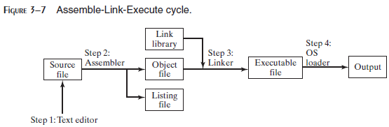
What Are Assemblers and Linkers?
Assembler is a utility program that converts source code programs from assembly language into an object file, a machine language translation of the program. Optionally a Listing file is also produced. We’ll use MASM as our assembler.
The linker reads the object file and checks to see if the program contains any calls to procedures in a link library. The linker copies any required procedures from the link library, combines them with the object file, and produces the executable file. Microsoft 16-bit linker is LINK.EXE and 32-bit is Linker LINK32.EXE.
OS Loader: A program that loads executable files into memory, and branches the CPU to the program’s starting address, (may initialize some registers (e.g. IP) ) and the program begins to execute.
Debugger is a utility program, that lets you step through a program while it’s running and examine registers and memory
MASM provides CodeView, TASM provides Turbo Debugger and msdev.exe for 32-bit Window console programs.

Slide 12
Listing File
A listing file contains:
a copy of the program’s source code,
with line numbers,
the numeric address of each instruction,
the machine code bytes of each instruction (in hexadecimal), and
a symbol table.
The symbol table contains the names of all program identifiers, segments, and related information.

Slide 13
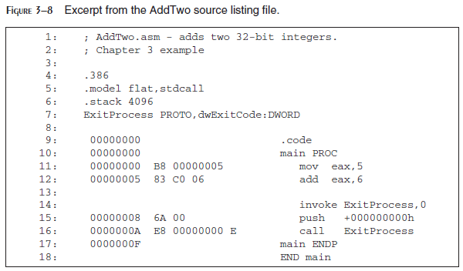

Slide 14
Assembly Language for x86 Processors
Assembly Language for x86 Processors focuses on programming microprocessors compatible with the Intel IA-32 and AMD x86 processors running under Microsoft Windows.
Assembly language bears the closest resemblance to native machine language.
It provides direct access to computer hardware, requiring you to understand much about your computer’s architecture and operating system.

Slide 15
Is Assembly Language Portable?
A language whose source programs can be compiled and run on a wide variety of computer systems is said to be portable.
A C++ program, for example, should compile and run on just about any computer, unless it makes specific references to library functions that exist under a single operating system.
A major feature of the Java language is that compiled programs run on nearly any computer system.

Slide 16
Is Assembly Language Portable?
Assembly language is not portable because it is designed for a specific processor family.
There are a number of different assembly languages widely used today, each based on a processor family.
Some well-known processor families are Motorola 68x00, x86, SUN Sparc, Vax, and IBM-370.
The instructions in assembly language may directly match the computer’s architecture or they may be translated during execution by a program inside the processor known as a microcode interpreter.

Slide 17
What you’ll learn from Assembly Language Programming
You will learn:
Some basic principles of computer architecture, as applied to the Intel IA-32 processor family.
How IA-32 processors manage memory, using real mode, protected mode, and virtual mode.
How high-level language compilers (such as C++) translate statements from their language into assembly language and native machine code.
How high-level languages implement arithmetic expressions, loops, and logical structures at the machine level.

Slide 18
What you’ll learn from Assembly Language Programming
You will improve your machine-level debugging skills.
Even in C++, when your programs have errors due to pointers or memory allocation, you can dive to the machine level and find out what really went wrong.
High-level languages purposely hide machine-specific details, but sometimes these details are important when tracking down errors.
Assembly language will help you understanding the interaction between the computer hardware, operating system, and application programs.

Slide 19
Applications of Assembly Language
Embedded systems programs are written in C, Java, or assembly language, and downloaded into computer chips and installed in dedicated devices.
Some examples are automobile fuel and ignition systems, air-conditioning control systems, security systems, flight control systems, hand-held computers, modems, printers, and other intelligent computer peripherals.
Many dedicated computer game machines have stringent memory restrictions, requiring programs to be highly optimized for both space and runtime speed.
Game programmers use assembly language to take full advantage of specific hardware features in a target system.

Slide 20
Virtual Machine Concept
Virtual Machine Concept:
An effective way to explain how a computer’s hardware and software are related is called the virtual machine concept.
Specific Machine Levels

Slide 21
Virtual Machines
Virtual machine is a software program that emulates the functions of some other physical or virtual computer.
Programming Language analogy:
Each computer has a native machine language (language L0) that runs directly on its hardware
A more human-friendly language is usually constructed above machine language, called Language L1
The virtual machine VM1, can execute commands written in language L1.
The virtual machine VM0 can execute commands written in language L0

Slide 22
Virtual Machines (Continue…)
Programs written in L1 can run in two different ways:
Translation – L1 program is completely translated into an L0 program (which then runs on the computer hardware)
Interpretation – L0 program interprets and executes L1 instructions one by one

Slide 23
Translating Languages
English: Display the sum of A times B plus C.
C++: cout << (A * B + C);
Assembly Language:
mov eax,A
mul B
add eax,C
call WriteInt
Intel Machine Language:
A1 00000000
F7 25 00000004
03 05 00000008
E8 00500000

Slide 24
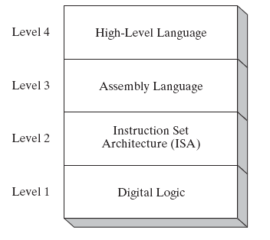
Specific Machine Levels
(descriptions of individual levels follow . . . )

Slide 25
High-Level Language
Level 4
Application-oriented languages
C++, Java, Pascal, Visual Basic . . .
Programs compile into assembly language (Level 3)

Slide 26
High-Level Language
The Java programming language is based on the virtual machine concept.
A program written in the Java language is translated by a Java compiler into Java byte code - a low-level language quickly executed at runtime by a program known as a Java virtual machine (JVM).

Slide 27
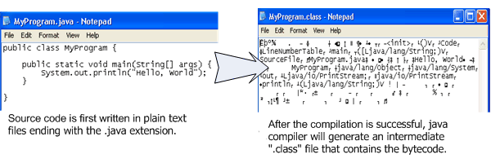
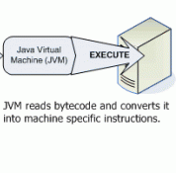
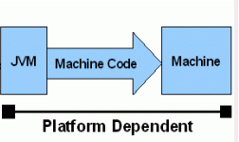
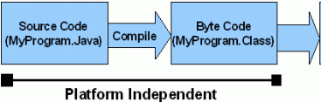
Interpret
Java code / Bytecode is always the same on different OS. That makes java program as platform independent.
JVM is platform dependent that means there are different implementation of JVM on different OS.

Slide 28
Assembly Language
Level 3
Instruction mnemonics that have a one-to-one correspondence to machine language
Programs are translated into Instruction Set Architecture Level - machine language (Level 2)
The instructions in assembly language may directly match the computer’s architecture or they may be translated during execution by a program inside the processor known as a microcode interpreter.

Slide 29
Instruction Set Architecture (ISA)
Level 2
Also known as conventional machine language
Executed by Level 1 (Digital Logic)

Slide 30
Digital Logic
Level 1
CPU, constructed from digital logic gates
System bus
Memory
Implemented using bipolar transistors

